Slide 1

Microprocessor & Computer Architecture (μpCA)
UE19CS252
Dr. D. C. Kiran
Department of
Computer Science and Engineering

Slide 2

Microprocessor & Computer Architecture (μpCA)
INTERRUPTS
Dr. D. C. Kiran
Department of Computer Science and Engineering

Slide 3
Syllabus
Unit 1: Basic Processor Architecture and Design
Microprocessor Overview
CISC VS RISC
Introduction to ARM Processor & Applications
ARM Architecture Overview
Different ARM processor Modes
Register Bank
ARM Program structure
ARM Instruction Format
ARM INSTRUCTION SET
Data Processing Instructions
Flow Control Instructions
Data Transfer Instructions
Block Transfer Instructions (Stack & Procedure Call)
Multiplication
MSR & MRS Instructions
Swap
Interrupts

Slide 4
ARM instruction set
Data processing
instructions
Data transfer
instructions
Block transfer
instructions
Branching / Flow Control instructions
Multiply, PSR, SWAP instructions
Software interrupt
instructions

Slide 5



What is Interrupt/Exception?
Main ()
{
:
Doing something
(e.g.browsing)
:
} ring
Can happen anytime
Depends on types of interrupts
Phone rings
Phone rings
_isr() // Interrupt service routine
{
some tasks (e.g. answer
telephone)
} //when finished,
//goes back to main

Slide 6
Interrupts
Interrupts
Reset
(or power up)
Software
Interrupt
SWI-XX
Hardware
Interrupt
FIQ,IRQ
Timer
ADC
External
Interrupt
EINT
SWI
Triggered by the software instruction SWI x
Triggered by hardware sources
Triggered by power_up/
reset_key
6

Slide 7
Many sources of “events” during program execution
Application makes a system call
Software executes instruction illegally (e.g. divides by zero)
Peripheral needs attention or has completed a requested action
How do we know that an event has occurred?
Broadly, two options to “detect” events
Polling
We can repeatedly poll the app/processor/peripherals
When an event occurs, detect this via a poll and take action
Interrupts
Let the app/processors/peripheral notify us instead
Take action when such a notification occurs (or shortly later)
Reference

Slide 8
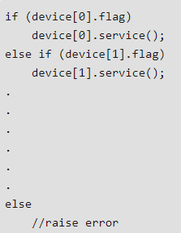
SOFTWARE METHOD – POLLING
To serve multiple interrupts generated by devices simultaneously
It’s a way to decide to which interrupt will be served first on priority.
A service program will decide which interrupt to serve based on priority
All the devices will be checked to see who has generated the interrupt.
If Flag bit of a device is set, itz interrupt service is served.
This process is slow

Slide 9
Event Driven Tasks Execution
Each Event (Interrupt / Exception) has ISR
This is similar to the Sub-Routine call
Interrupt 1
ISR for
Interrupt 1
Normal Execution
Interrupt 2
ISR for
Interrupt 2
Where is the ISR?
Somewhere in Code part of Main Memory

Slide 10
Interrupt Service Routine (ISR)
The ISR is a piece of code that's responsible for clearing the source of the interrupt.
ISR is also called device driver in case of the devices and called exception or signal or trap handler in case of software interrupts

Slide 11
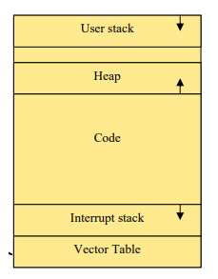
Event Driven Tasks Execution
How the processor determines where the ISR is located in code memory for the specific interrupt?
Microprocessor make use of Interrupt Vector Tables to find the starting address of ISR routines.
Main Memory
Reference

Slide 12
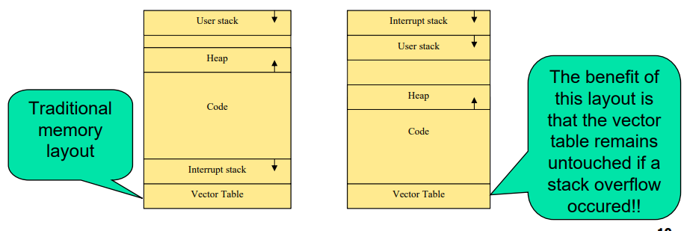

Slide 13
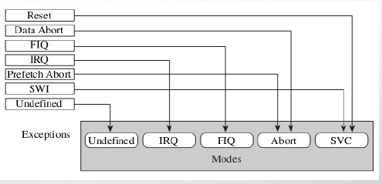
0x1C
FIQ
0x18
IRQ
0x14
(Reserved)
SWI
0x10
Data Abort
0x0C
Prefetch Abort
0x08
Software Interrupt
0x04
Undefined Instruction
Reference 1
0x00
Reset
Reference 2
Vector Table

Slide 14
0x1C
FIQ
0x18
IRQ
SWI
At this place in Memory, the Branch Instruction to the ISR can be found.
ldr pc, [pc, #_SWI_handler_offset]
0x14
(Reserved)
0x10
Data Abort
0x0C
Prefetch Abort
0x08
Software Interrupt
0x04
Undefined Instruction
0x00
Reset
Vector Table

Slide 15
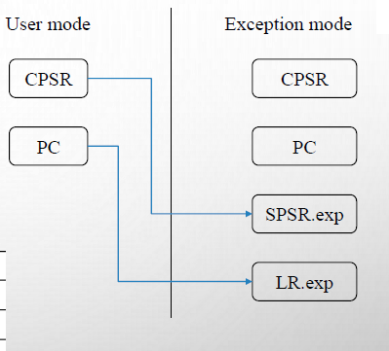
ARM Exception Handling
Saves the CPSR to the SPSR of the Exception Mode
Saves the PC to the LR of the Exception mode
Sets the CPSR to the Exception Mode
Sets PC to the address of the Exception Handler

Slide 16
Handling IRQ and FIQ Interrupts
M=USER
CPSR.I=0
CPSR.F=0
IRQ Interrupt
M=IRQ
CPSR.I=1
CPSR.F=0
Return to User Code
ISR

Slide 17
Handling IRQ and FIQ Interrupts
M=USER
CPSR.I=0
CPSR.F=0
FIQ Interrupt
M=FIQ
CPSR.I=1
CPSR.F=1
Return to User Code
ISR

Slide 18
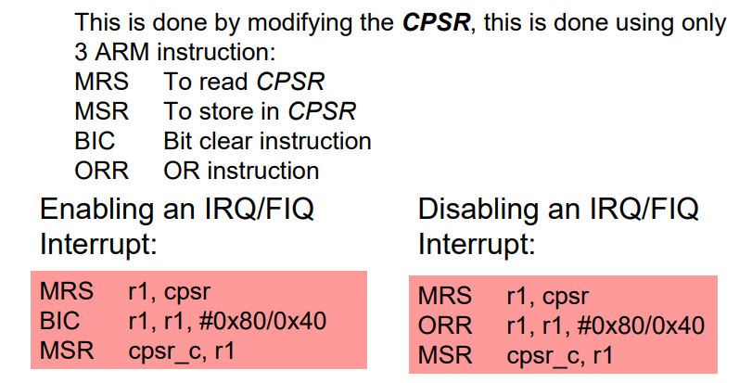
Note the following
I is 7th Bit in CPSR
F is 6th Bit in CPSR
0x80= 128 in binary 2^7
0x40 = 64 in binary 2^6

Slide 19
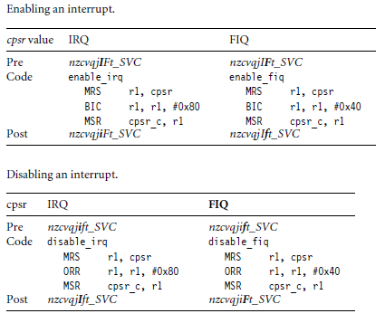
Enabling and Disabling FIQ and IRQ Exceptions

Slide 20
SWI #
31
28
27
24
23
0
Cond 1 1 1 1
Comment field (ignored by Processor)
Condition Field
In effect, a SWI is a user-defined instruction.
It causes an exception trap to the SWI hardware vector (thus causing a change to supervisor mode, plus the associated state saving), thus causing the SWI exception handler to be called.
The handler can then examine the comment field of the instruction to decide what operation has been requested.
By making use of the SWI mechansim, an operating system can implement a set of privileged operations which applications running in user mode can request.

Slide 21
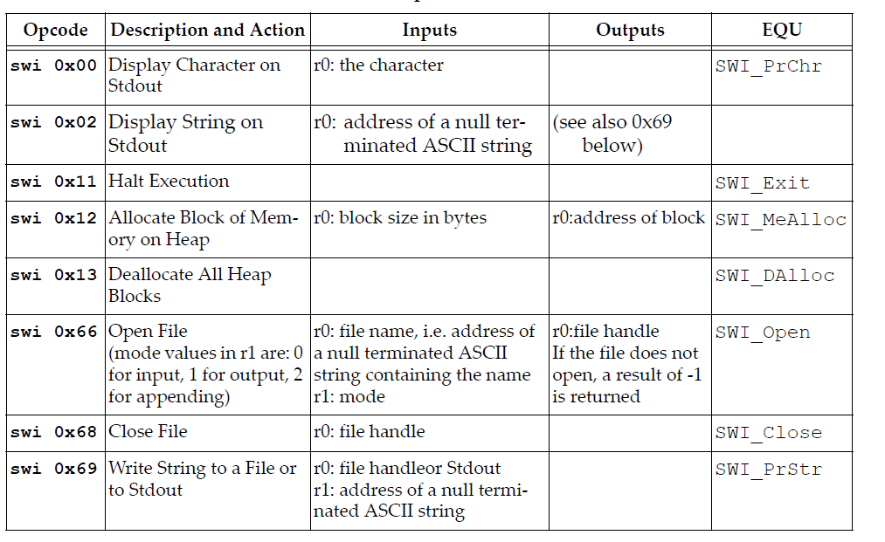
SWI #

Slide 22
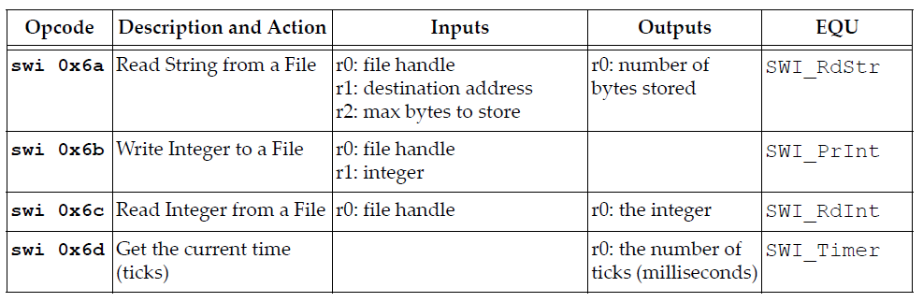
SWI #

Slide 23
A procedure to compute the statement in high level language using ARM ALP.
if (R0==R1) R2++;
MOV R0, #10
MOV R1, #10
BL GREAT
SWI 0x11 ; terminate the program / logical end.
GREAT: CMP R0, R1
ADDEQ R2, R2, #1
MOV PC, LR

Slide 24
A program to display a string on the screen using ARM ALP.
printf(“ Hello World”);
LDR R1, =A
LOOP: LDRB R0, [R1], #1
CMP R0, #0
SWINE 0x00 ; display a character on the screen.
BNE LOOP
SWI 0x11 ; terminate the program.
.DATA
A: .ASCIZ “HELLO WORLD”

Slide 25
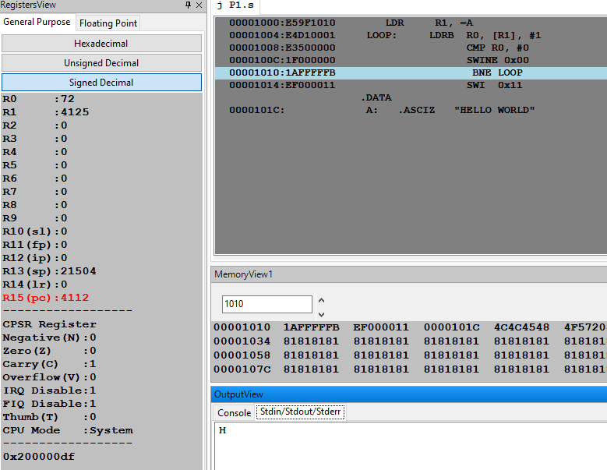

Slide 26
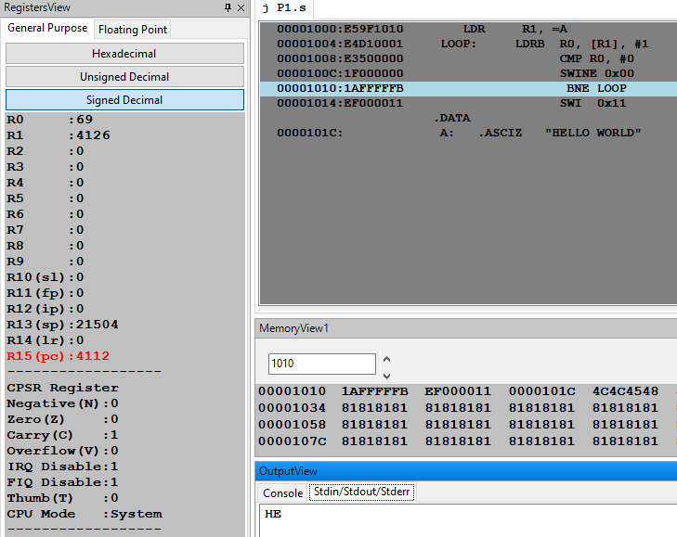

Slide 27
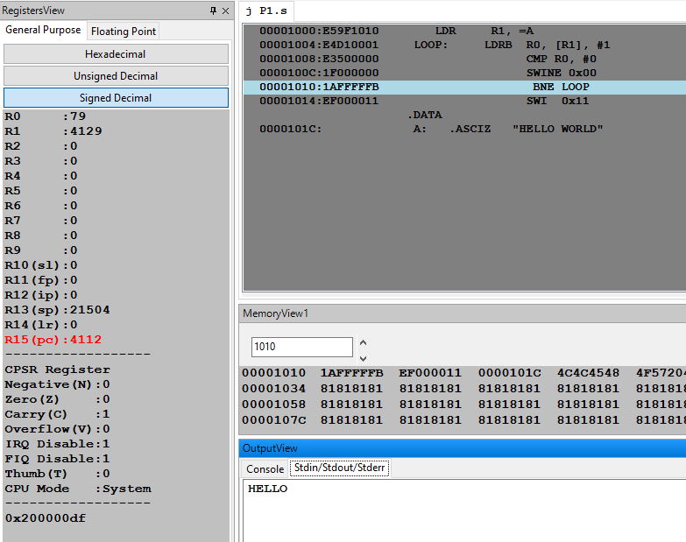

Slide 28
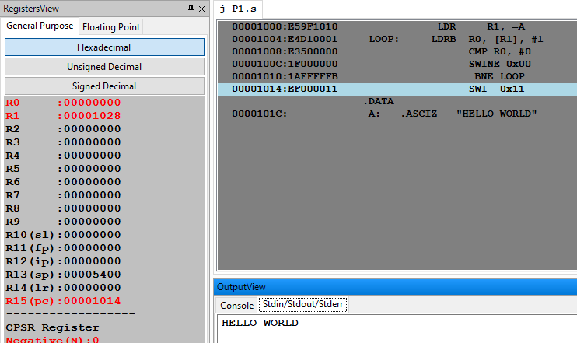

Slide 29
A procedure to display a string on the screen using ARM ALP.
// printf (“ Hello World”);
LDR R0, =A
SWI 0x02 ; display a string on the screen
SWI 0x11
.DATA
A: .ASCIZ “HELLO WORLD”

Slide 30
.equ SWI_Open, 0x66 ;open a file
.equ SWI_Close,0x68 ;close a file
.equ SWI_PrChr,0x00 ; Write 1 byte to file handle
.equ SWI_RdBytes, 0x6a ; Read n bytes from file handle
.equ SWI_WrBytes, 0x69 ; Write n bytes to file handle
.equ Stdin, 0 ; 0 is the file descriptor for STDIN
.equ Stdout, 1 ; Set output target to be Stdout
.equ SWI_Exit, 0x11 ; Stop execution

Slide 31
Program to Read an Integer from file and Display
.data
filename:.asciz "input.txt"
.text
.global _start
_start:
ldr r0, =filename
mov r1, #0
swi SWI_Open_File
mov r5, r0
swi SWI_Read_Int
mov r1, r0
mov r0, #1
swi SWI_Print_Int
mov r0, r5
swi SWI_Close_File
swi SWI_Exit
.end
.equ SWI_Open_File, 0x66
.equ SWI_Read_Int, 0x6C
.equ SWI_Print_Int, 0x6B
.equ SWI_Close_File, 0x68
.equ SWI_Exit, 0x11

Slide 32
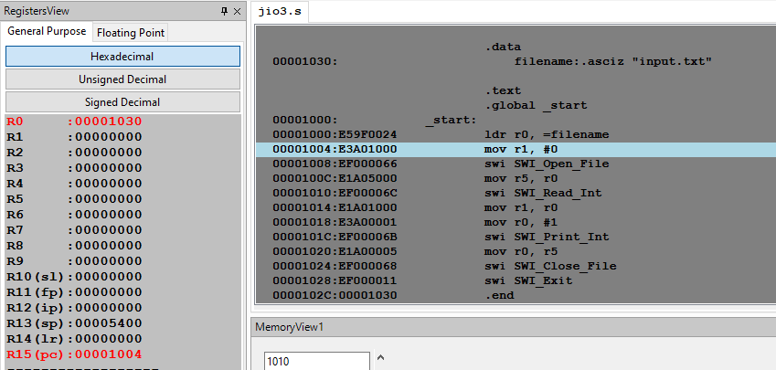
Program to Read an Integer from file and Display

Slide 33
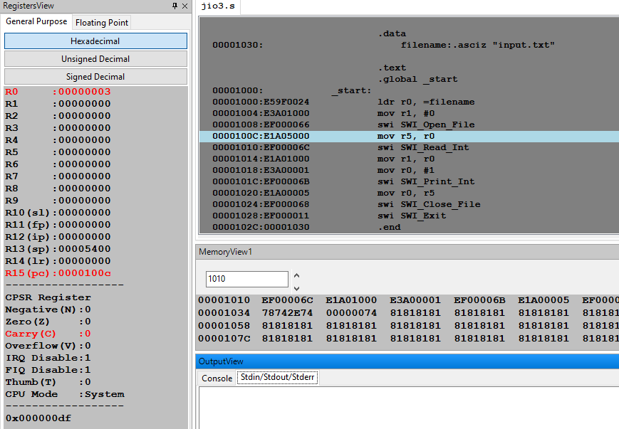
Program to Read an Integer from file and Display

Slide 34
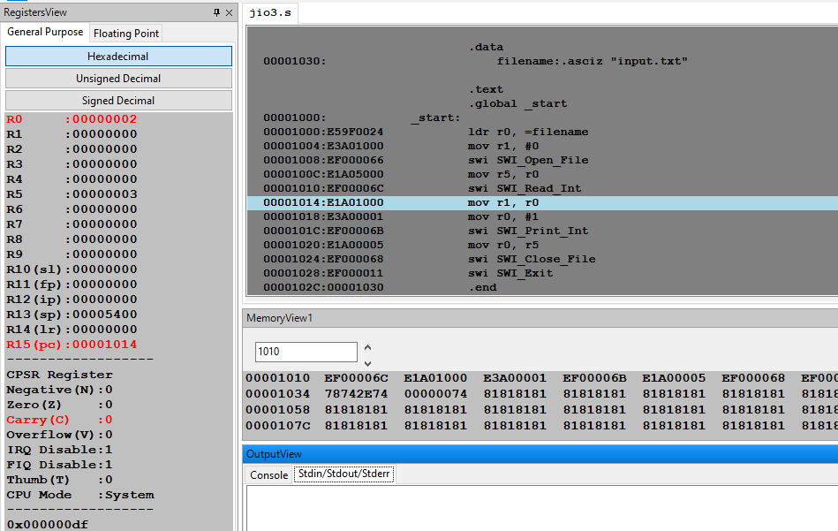
Program to Read an Integer from file and Display

Slide 35
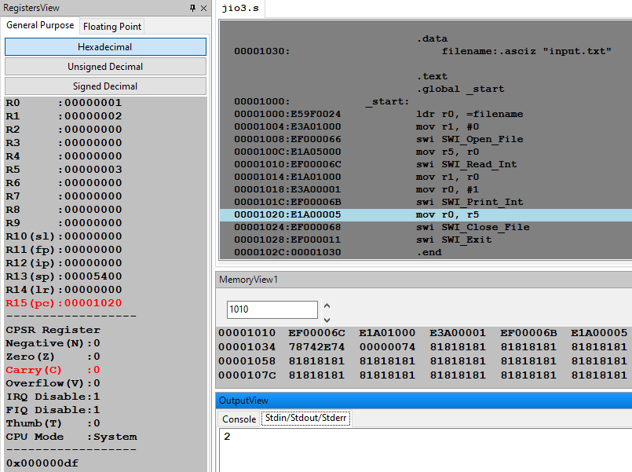
Program to Read an Integer from file and Display

Slide 36
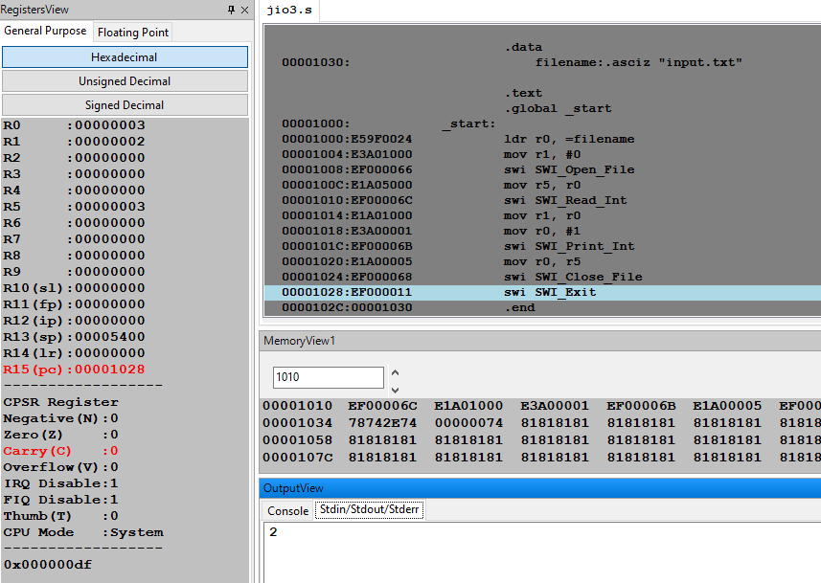
Program to Read an Integer from file and Display

Slide 37
Next Session
Instruction Encoding

Slide 38
THANK YOU
Dr. D. C. Kiran
Department of Computer Science and Engineering
dckiran@pes.edu
9829935135

